Slide 1
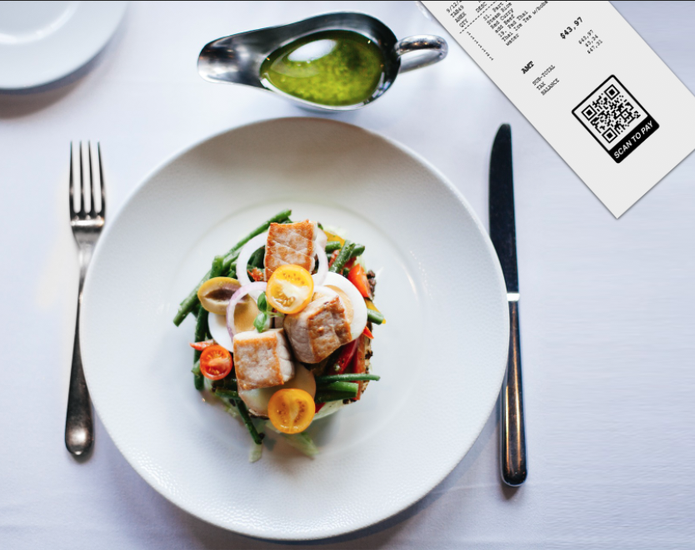

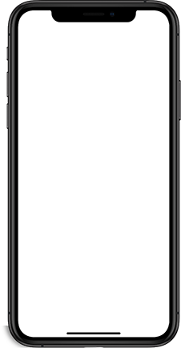
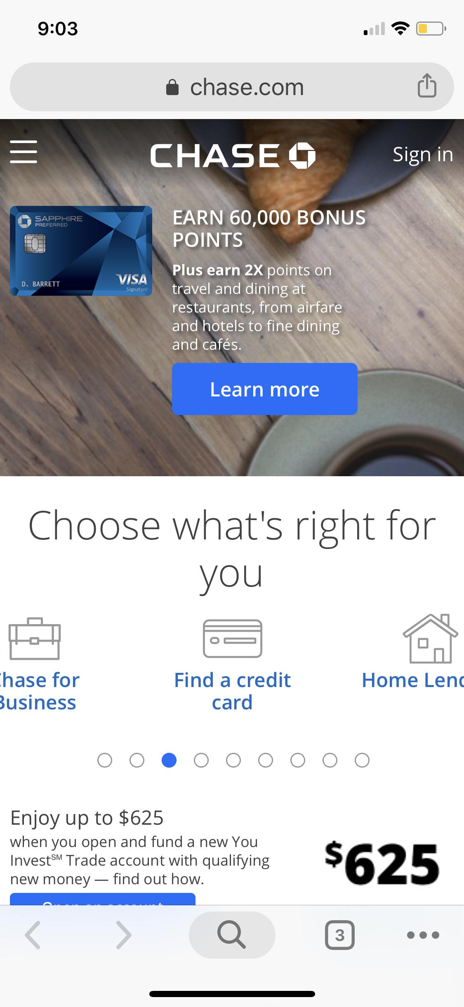
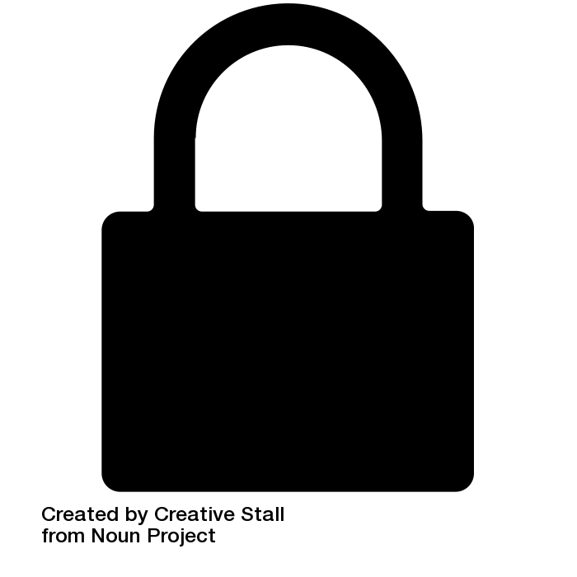
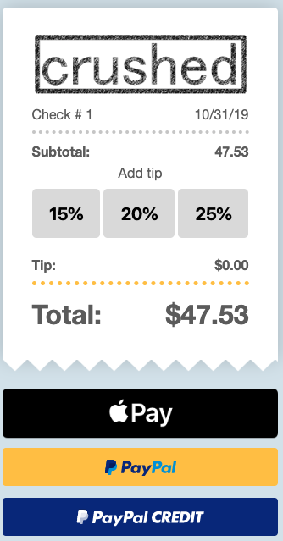

QR-CODE.IO
qr-code.io
QR Code Payments for Restaurants and Bars

Slide 2
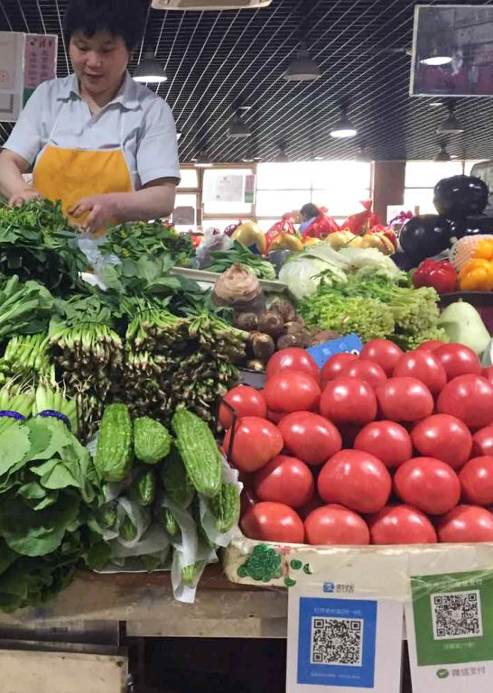
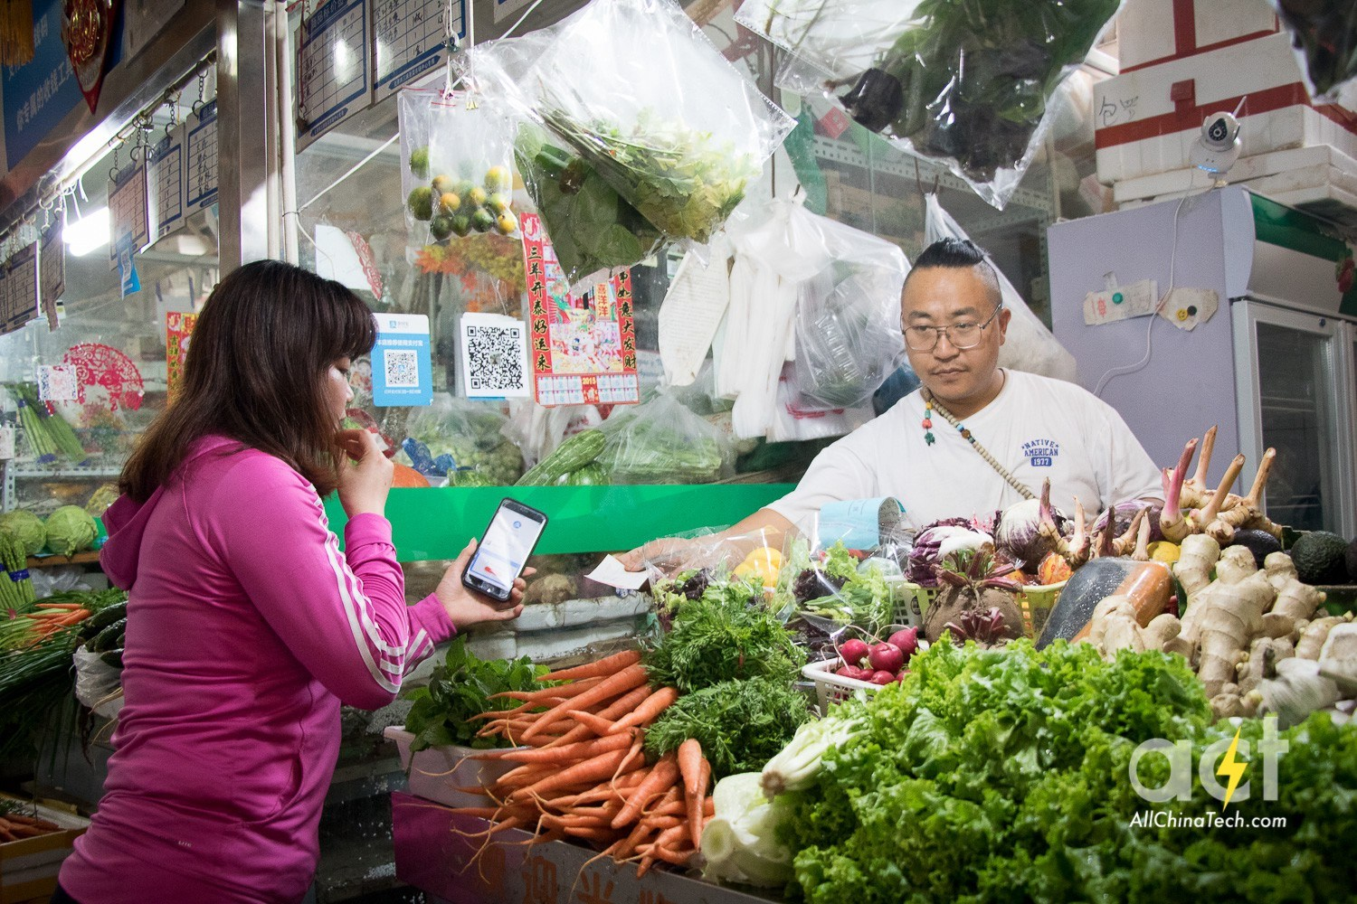
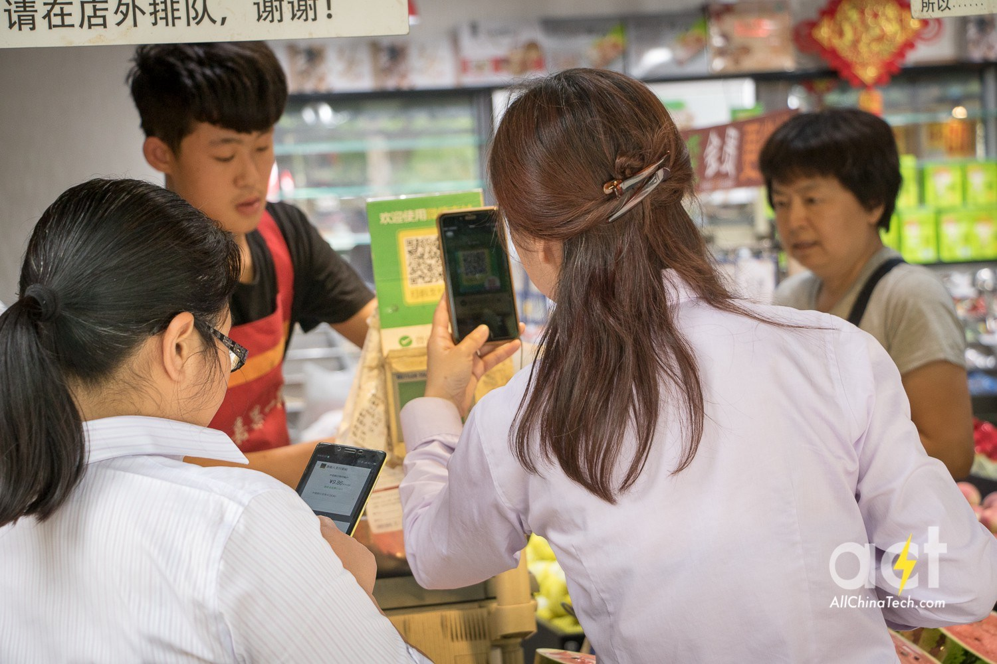

QR payments reached $3.23 trillion in China in 2018 iResearch Consulting Group
It’s nearly impossible to overstate the ubiquity of QR codes in China. Used on everything from Omega watch ads, to payments, to reading ordering off a menu, or even calling a server. It allows users to interact with the physical work with their digital devices in real time.
“WeChat, China’s most popular messaging app, has an in-built QR Code scanner. An estimated half a billion people in China actively use WeChat on their smartphones...This removes the need to download a dedicated QR Code scanning app - a problem prevalent in the West.”

Slide 3
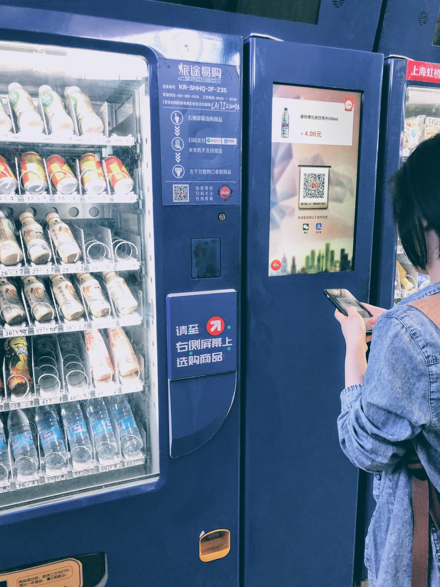
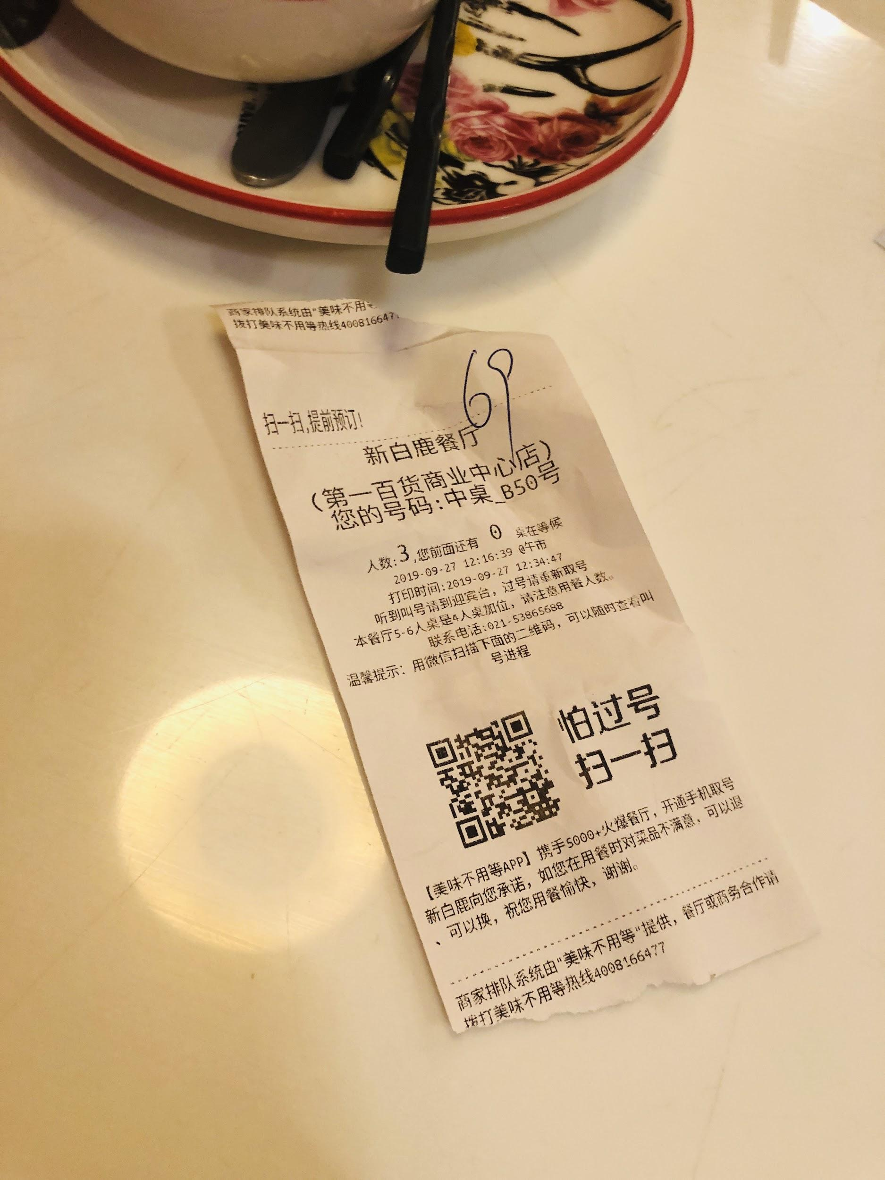
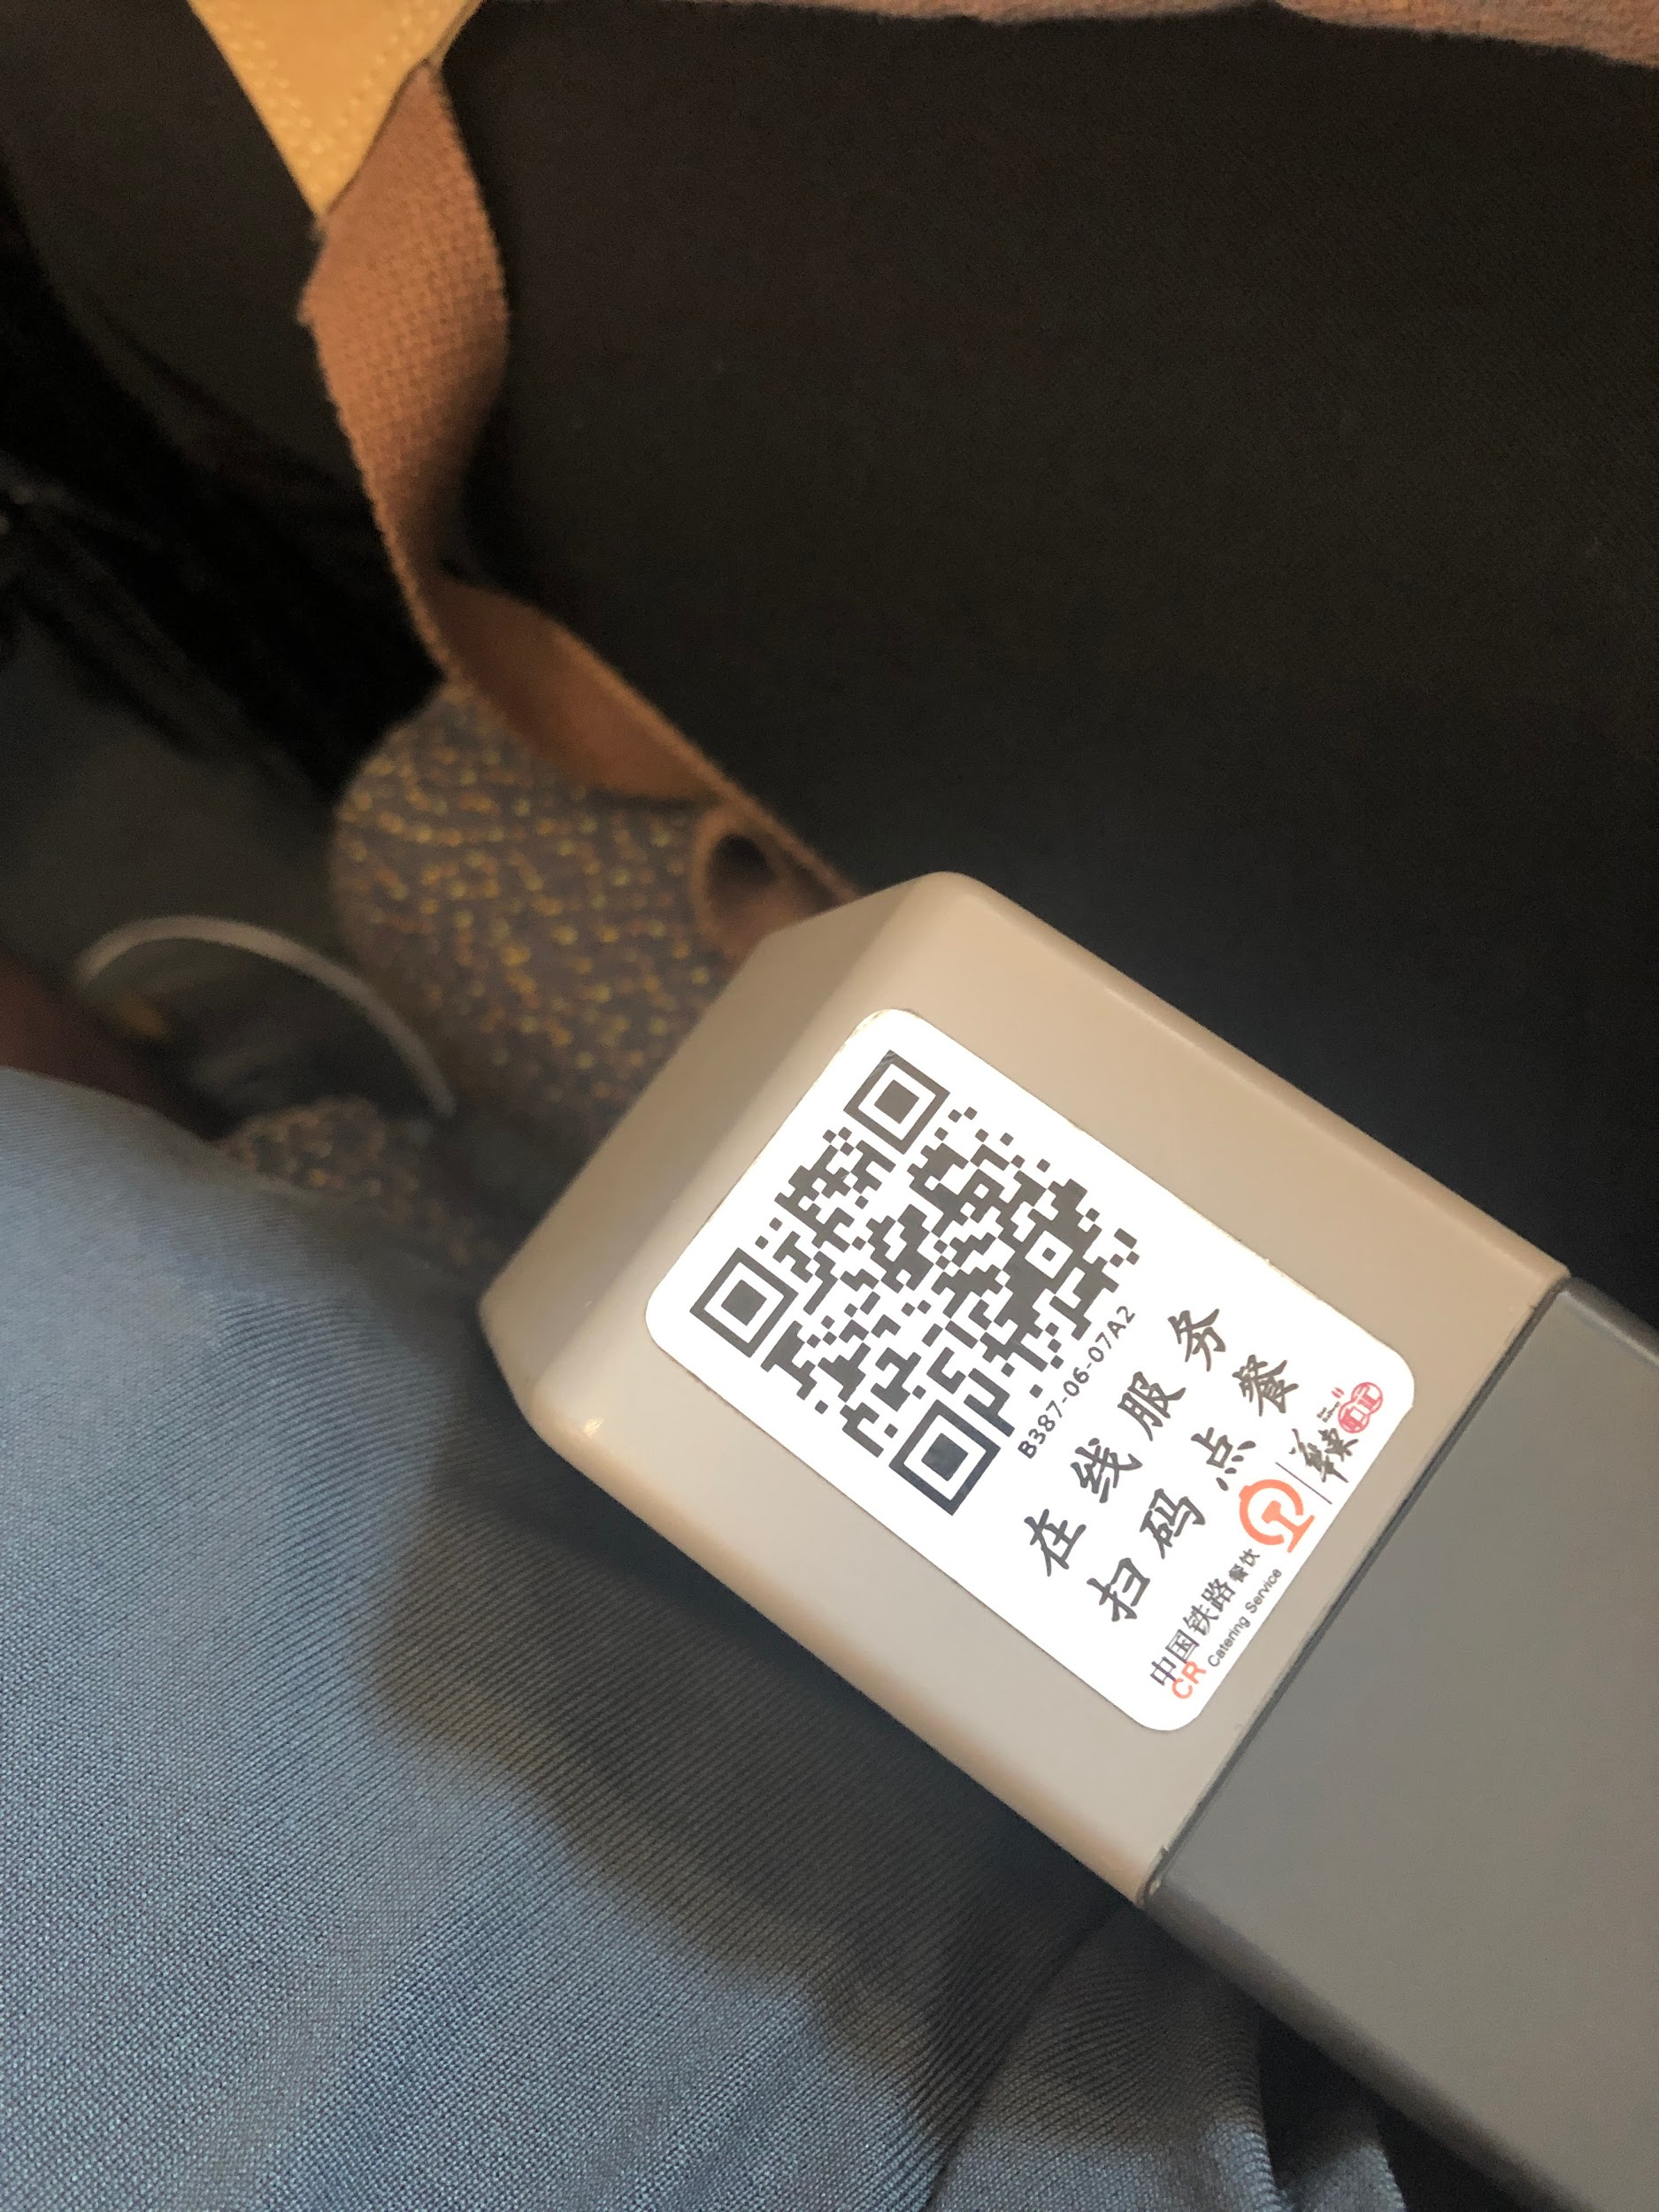
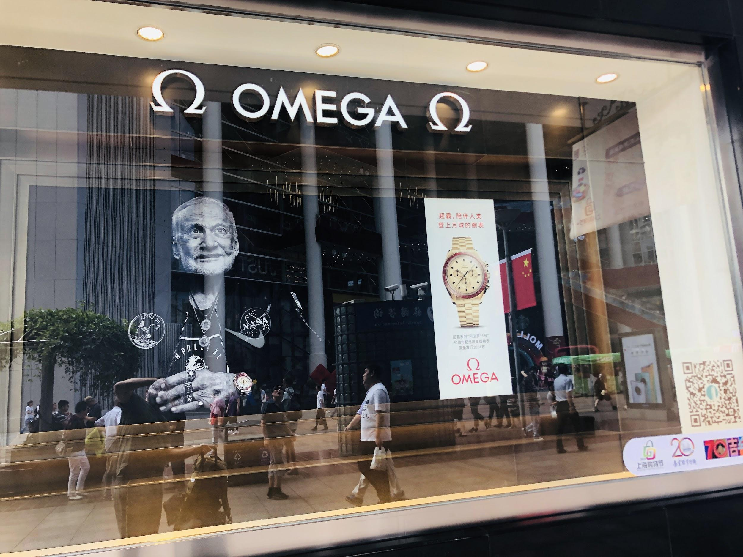

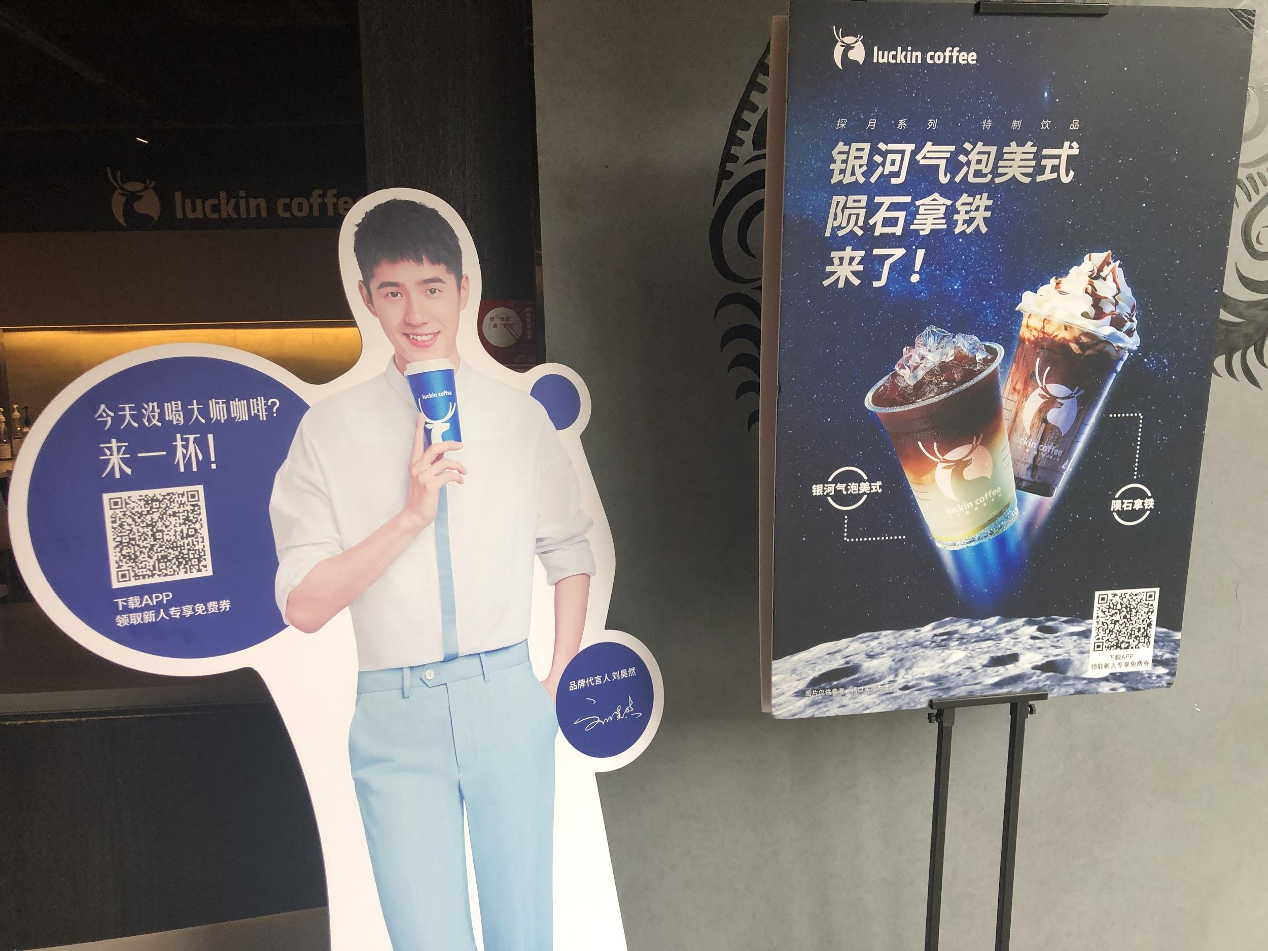
Mobile payment must become widespread in order to attract Chinese tourists
https://www.linkedin.com/pulse/qr-code-payments-chinese-revolution-annie-guo/
Vending machine in China that only accepts QR payments - no credit or cash.
Vending machine in China that only accepts QR payments - no credit or cash.

Slide 4

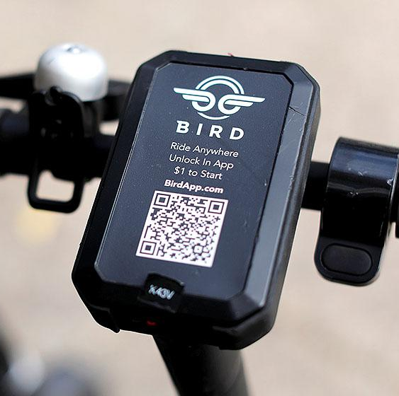


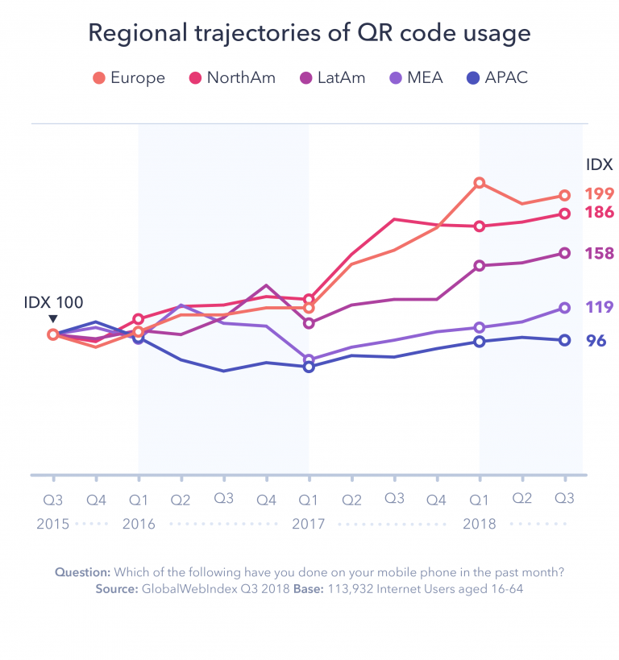

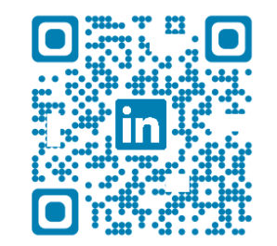
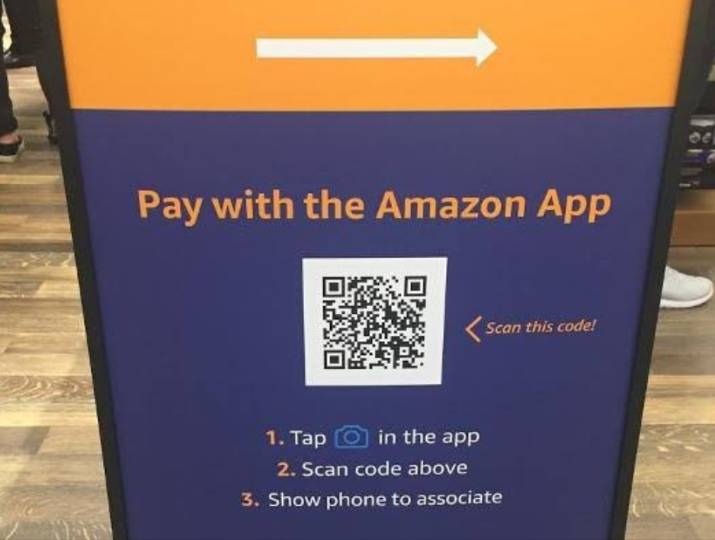

QR code use in 2019 in the US
QR code usage increases as age decreases, with use in Snapchat, fb messenger, twitter, pinterest, lime scooter, linkedin, instagram, and spotify.
Scanova
iOS & Android have native QR scanning
“In 2017, Apple’s iOS 11 incorporated a native QR code reader built into the camera app....Android phones got QR codes as native OS in early 2019 with the release of Android Pie” - Scanova
Scanned a QR code in the past month
GlobalWebIndex Q3 2018, North America, 113,932 users aged 16-64
Index 186
Need to get numbers, and update to 2020
Index 100
QR-CODE.IO

Slide 5
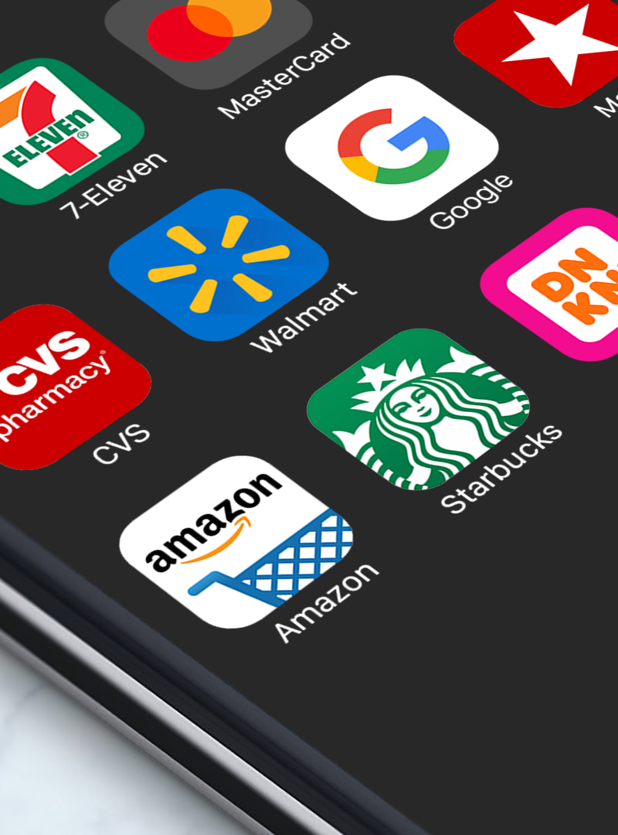
QR payments typically require an app for each brand
In China, this isn’t an issue because “WeChat, China’s most popular messaging app (an estimated half a billion users), has an in-built QR Code ecosystem.
Walmart, Target, Starbucks, Dunkin Donuts, 7-11, Macy’s, CVS all provide QR code payment at POS...with their app.
An app that requires download, account creation, payment info, email confirmation, etc. for use only to make payments at a specific retailer. The customers’ perceived benefit (i.e. loyalty) isn’t often enough to overcome the friction of setup.
QR-CODE.IO

Slide 6
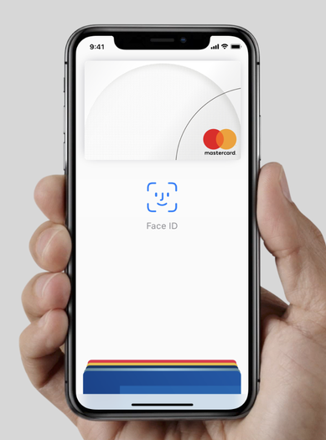
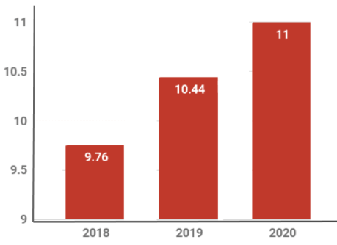
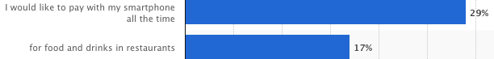
QR code use in the US
Yet mobile payments are on the rise in the US
“In 2017, Apple’s iOS 11 incorporated a native QR code reader built into the camera app....Android phones got QR codes as native OS in early 2019 with the release of Pie
Further reading - https://scanova.io/blog/do-people-use-qr-codes/
“PayPal Wallet, Apple Pay, Google Pay offer ways to streamline the check-out process.” - CNBC: Nov 29, 2019 - Mobile payments undermine banks’ battle for credit card dominance
the US - MacRumors October 23, 2019
“In what situations would you like to be able to pay with your smartphone (without debit/credit card or cash)?”
https://www.statista.com/forecasts/997133/mobile-payments-by-situation-in-the-us
“Nearly 64 million people (30% of all US smartphone users) are expected to use mobile payments in 2019, a 9.1% increase over 2018...Nearly 50% of all smartphone users are 25-34, so the growth of mobile payments is expected to be strongest in this age group, although growing across the board.” - Apple Pay Overtakes Starbucks as Most Popular Mobile Payment Platform in the US - MacRumors October 23, 2019
Expected QR Code Usage in U.S. Households (Millions)
QR-CODE.IO
QR-CODE.IO

Slide 7
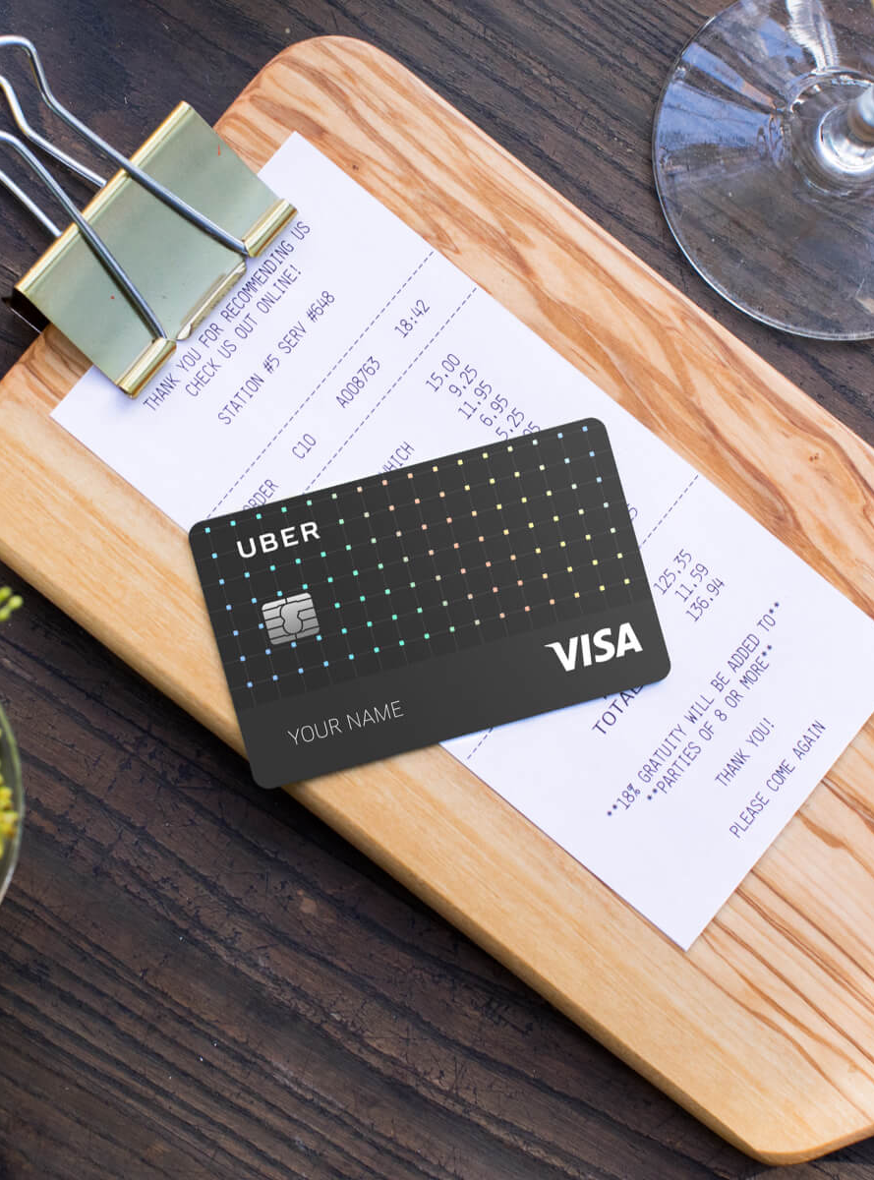
Why do we need an alternative to plastic?
In most physical retail scenarios the customer is standing in front of the POS to swipe, insert, or enter online. Plastic works well.
And with mobile purchases online, the card is stored for use.
In fact, paying online with Amazon is even easier than paying a plastic card in most retail.
QR-CODE.IO

Slide 8
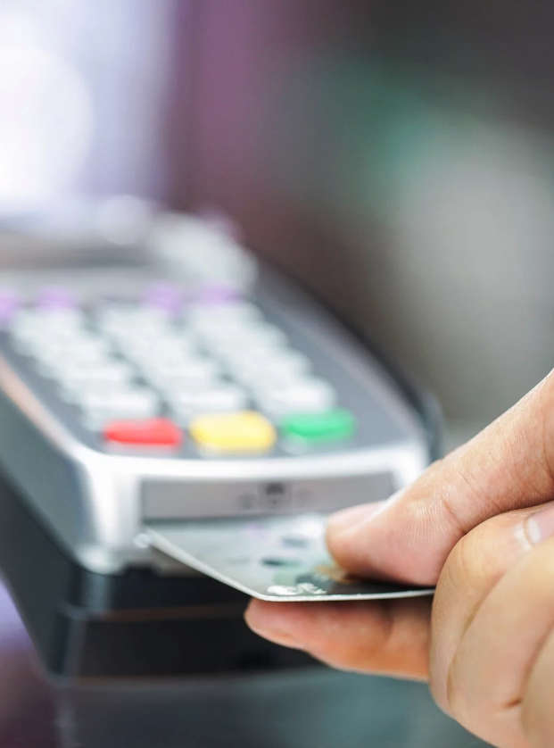
Why do we need an alternative to plastic?
In most physical retail scenarios the customer is standing in front of the POS to insert their card, or enter online. Plastic works well.
And with mobile purchases online, the card is stored for use.
Paying online with Amazon is often easier than paying a plastic card in most retail.
In restaurants and bars, however, the server has to act as a go-between the POS and customer because a tip is involved. There are costly inefficiencies (multiple trips from a table to a POS, ), rerunning tips later, and customers waiting to leave, not losing their card, mental math of tip, etc.
QR-CODE.IO

Slide 9
Focus on restaurants and bars
Restaurant and Bar receipts are an ideal touchpoint for several reasons. The receipt provides awareness for this payment method, from a trusted retailer, to an audience immediately ready to pay, and being away from home, likely with their phone nearby.
“The proliferation of mobile technology creates a significant change to the ordering, payments, and guest communications landscape...and the resurgence of QR codes” - Forbes.com (Nov 11, 2019) - The Future of Restaurant Tech
“Merchants that lack a point-of-sale device can simply post a piece of paper with their QR code near the register for customers to point their phones’ cameras at and execute payments in reverse.”
American Banker -
https://www.americanbanker.com/news/why-chinas-mobile-payments-revolution-matters-for-us-bankers
qr-code.io
QR-CODE.IO

Slide 10

QR-CODE.IO
QR Code Payments for Restaurants and Bars
No

Slide 11
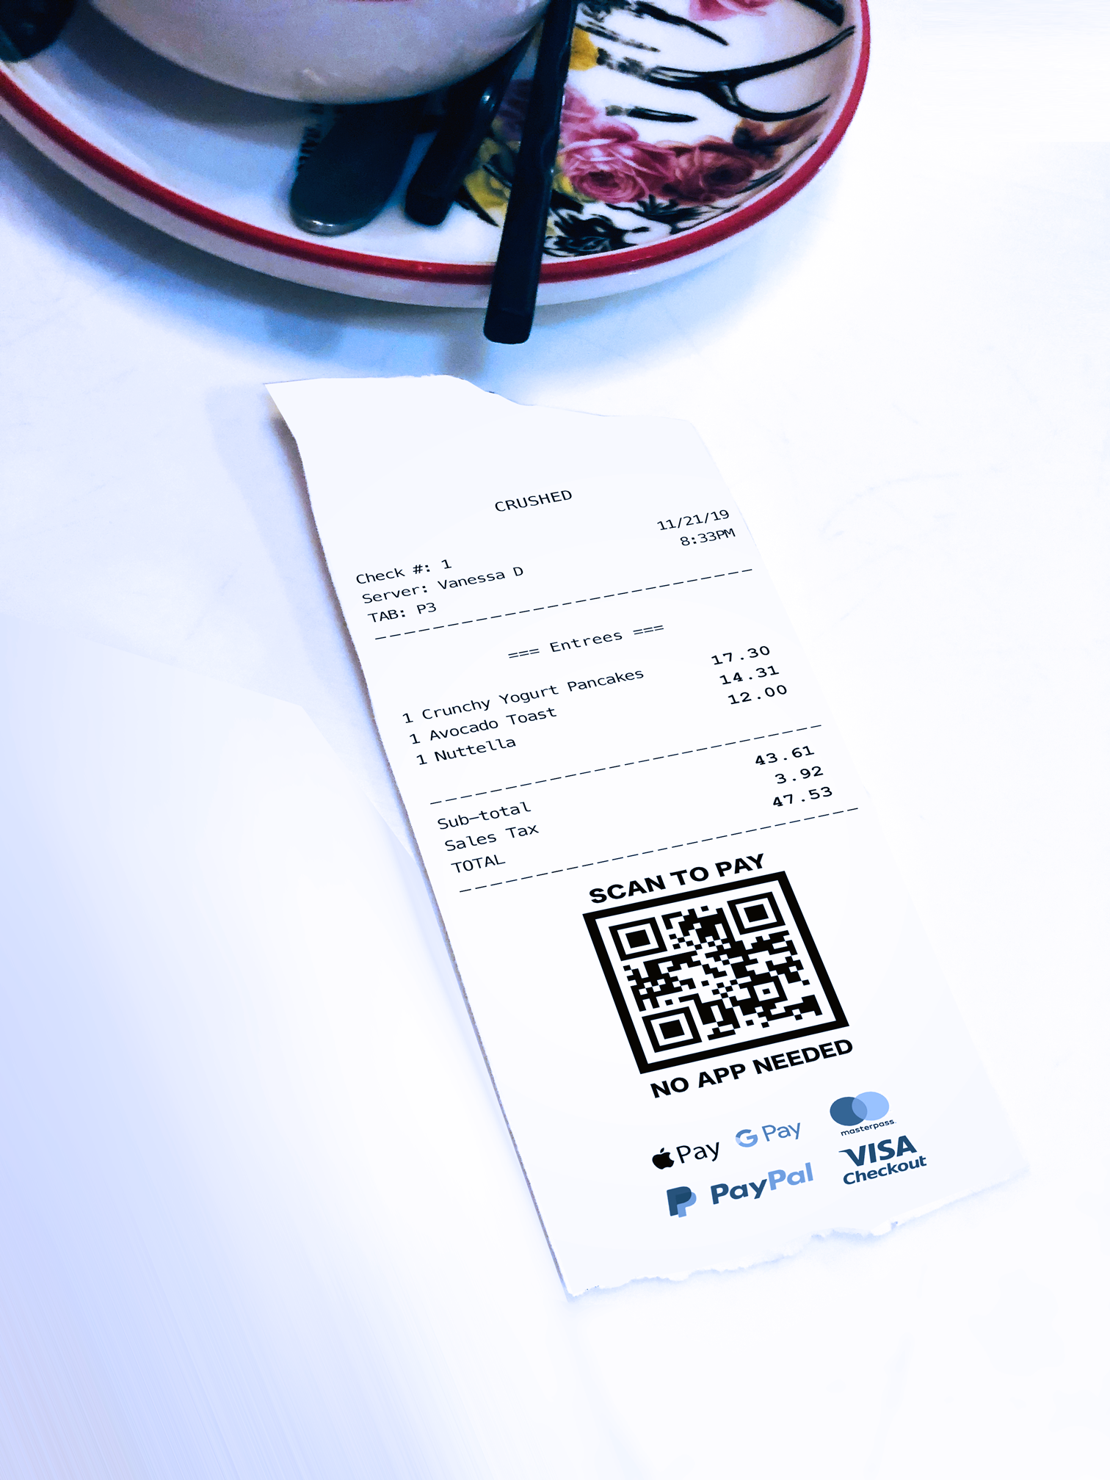
Qr-code.io doesn’t use an app or account
qr-code.io
A major hurdle for adoption for most other solutions is that they require an app. Users must see the value in using a retailer-specific app, then download the app, create an account, set up payment info, confirm email, etc.
Qr-code.io doesn’t need an app or account, using the native OS camera app, browser, and payment accounts already used previously. This means you can pay with Apple Pay, PayPal, or your Credit Card.
QR-CODE.IO

Slide 12
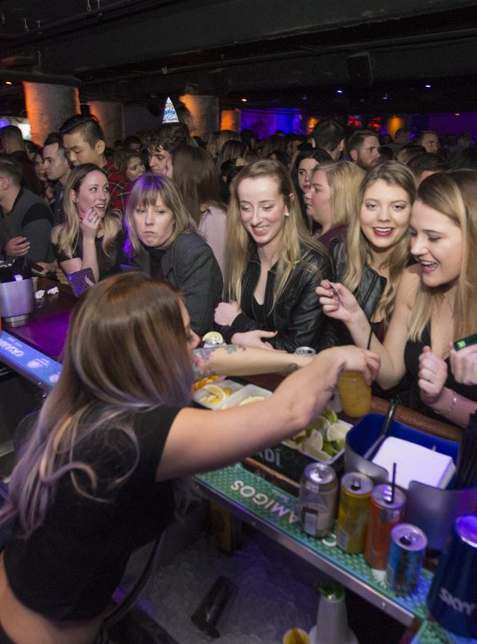
Faster than credit cards for servers and customers
Paying your bill in the US takes an average of 4 minutes, and requires 3 trips for the server. While QR payments paying your bill takes 0:20 seconds and requires only one trip by the server to drop off the check.
QR-CODE.IO

Slide 13
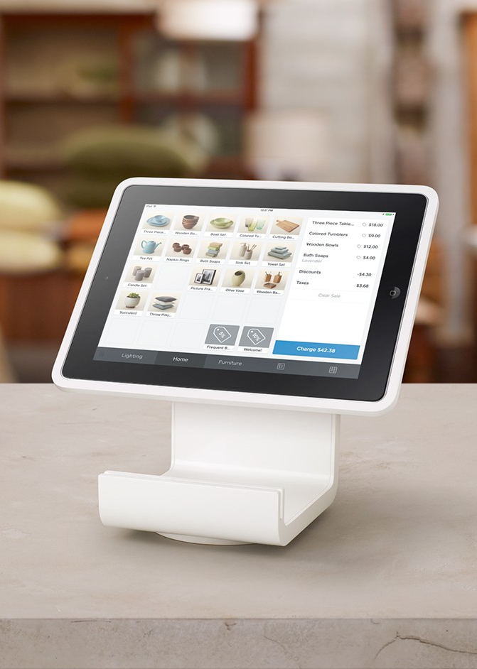
Simple POS Integrations
TouchBistro
Rezku POS
Harbortouch
Square for Restaurants
ShopKeep
Lightspeed Restaurant
Future POS
Upserve
QR-CODE.IO

Slide 14
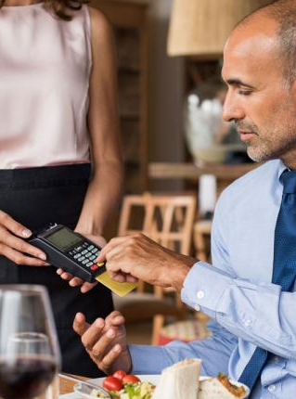
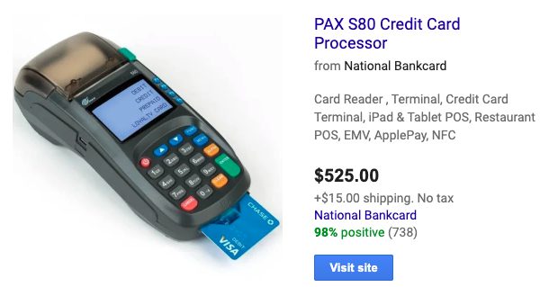
Cheaper than NFC
https://www.linkedin.com/pulse/nfc-vs-qr-code-payment-alex-tay/
https://www.bluebite.com/nfc/qr-vs-nfc
https://www.idsuperstore.com/learning-center/what-are-the-differences-between-nfc-tags-and-qr-codes/
https://www.fintechweekly.com/magazine/articles/mobil-payment-nfc-qr-codes-in-app-and-beyond
“I don't use it at my restaurant for several reasons…1) It’s one more piece of equipment to keep track of, that my staff could lose or someone could steal, 2) Added cost and 3) it wouldn’t make anything run faster or smoother.” -Susan Park, Quara.com
“Restaurant owners have little financial incentive in buying handheld POS machines. And it’s more work for servers...the current way is easier and allows them to attend other tables and earn more money. It’s all about money.” -Chris Garcia, Quara.com
Why Swiping Your Card at the Table Lags in the US - https://www.nerdwallet.com/blog/credit-cards/pay-at-table-dining-credit-cards/
QR-CODE.IO

Slide 15
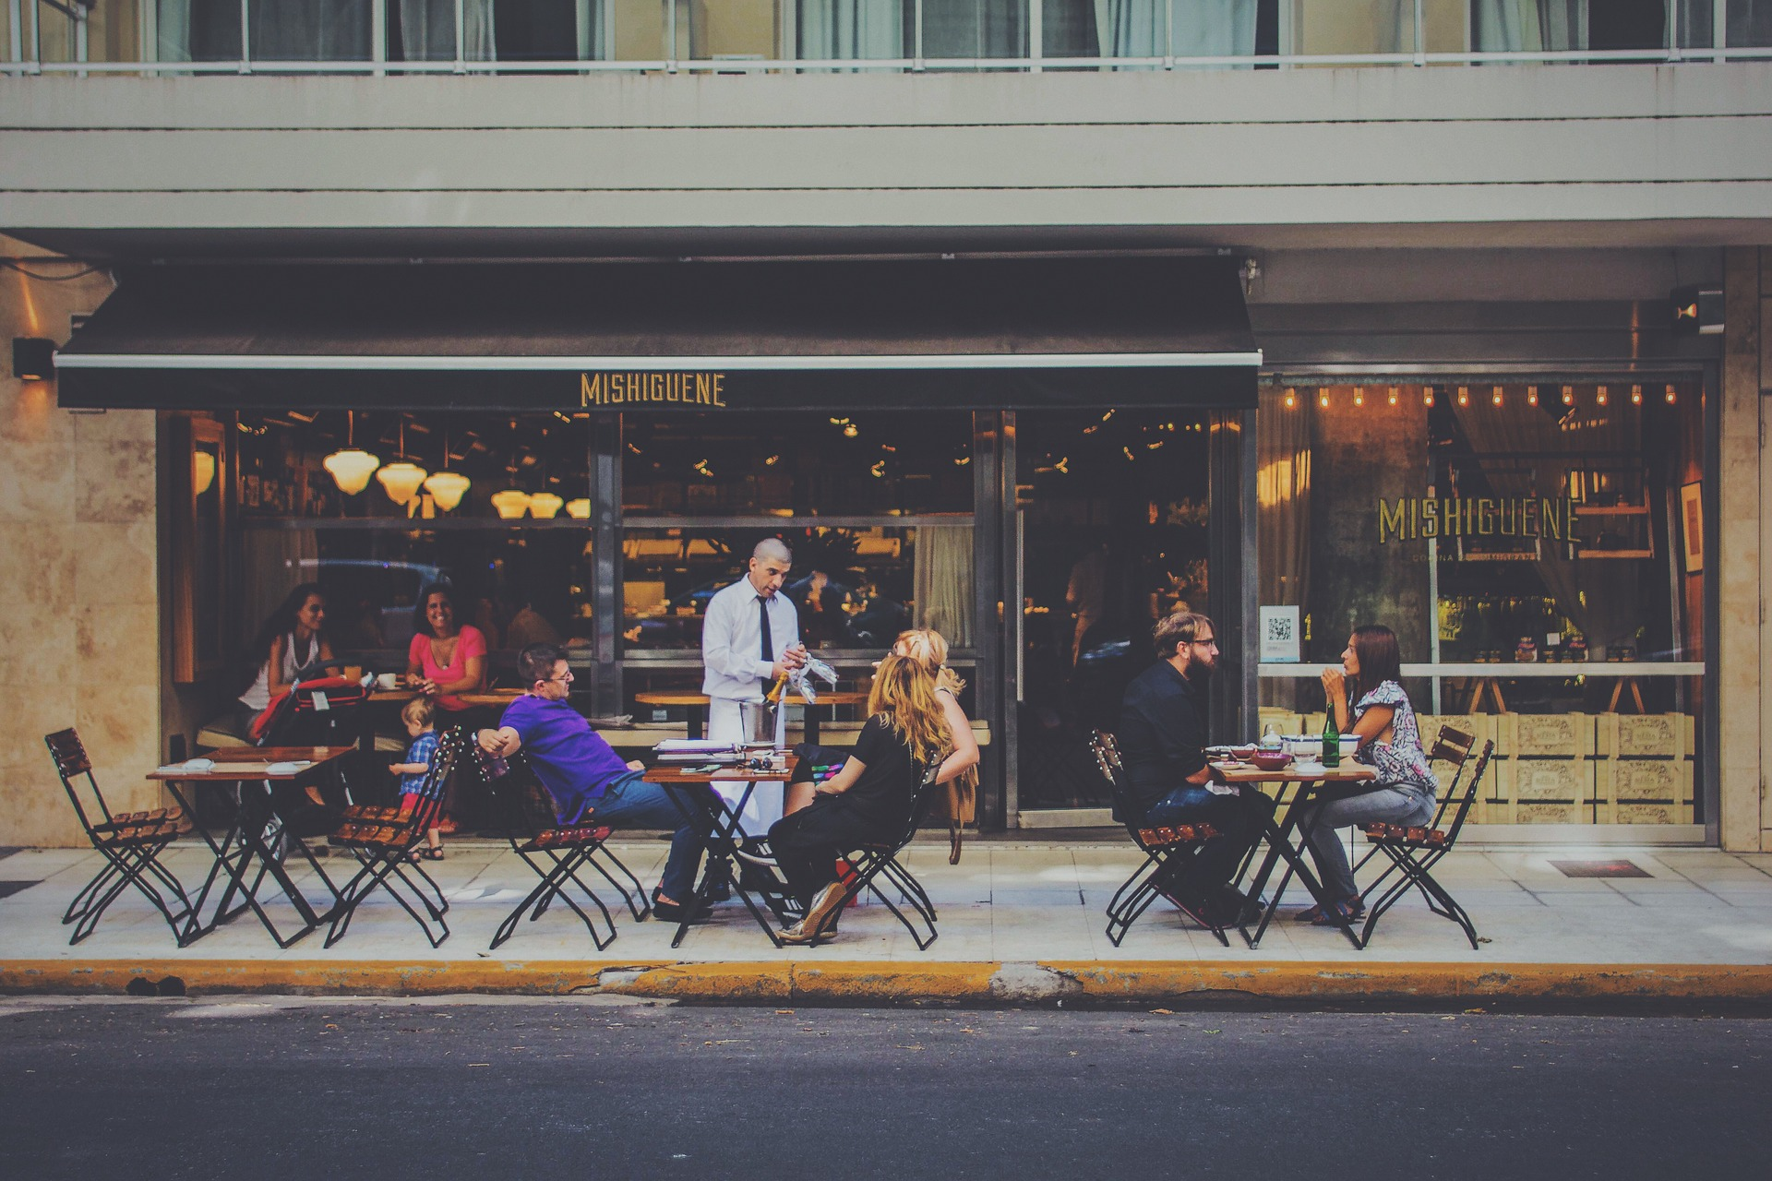
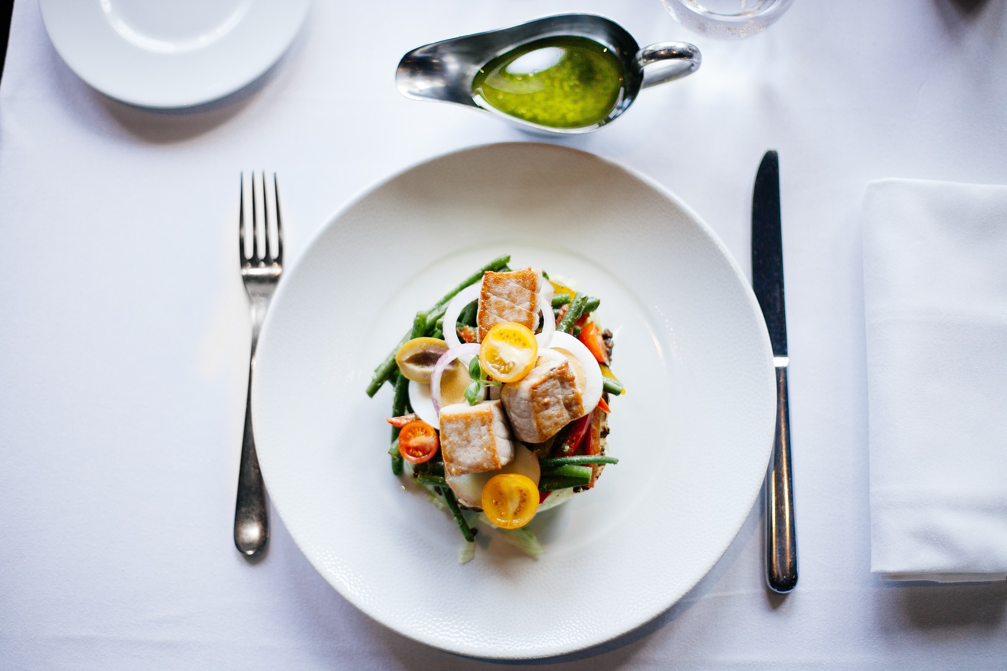
Additional benefits over cards and cash
No need to carry your wallet, as long as you have your phone. And you probably have that out already.
More secure than a credit card, because QR payment requires both a phone password and users logged into accounts. The payment info is encrypted end-to-end, like NFC or chip payments. And unlike mag stripe swiping.
Safer than cash
Can’t be stolen, funds are traceable.
More reading - Forbes: The Future of Restaurant Tech
QR-CODE.IO

Slide 16
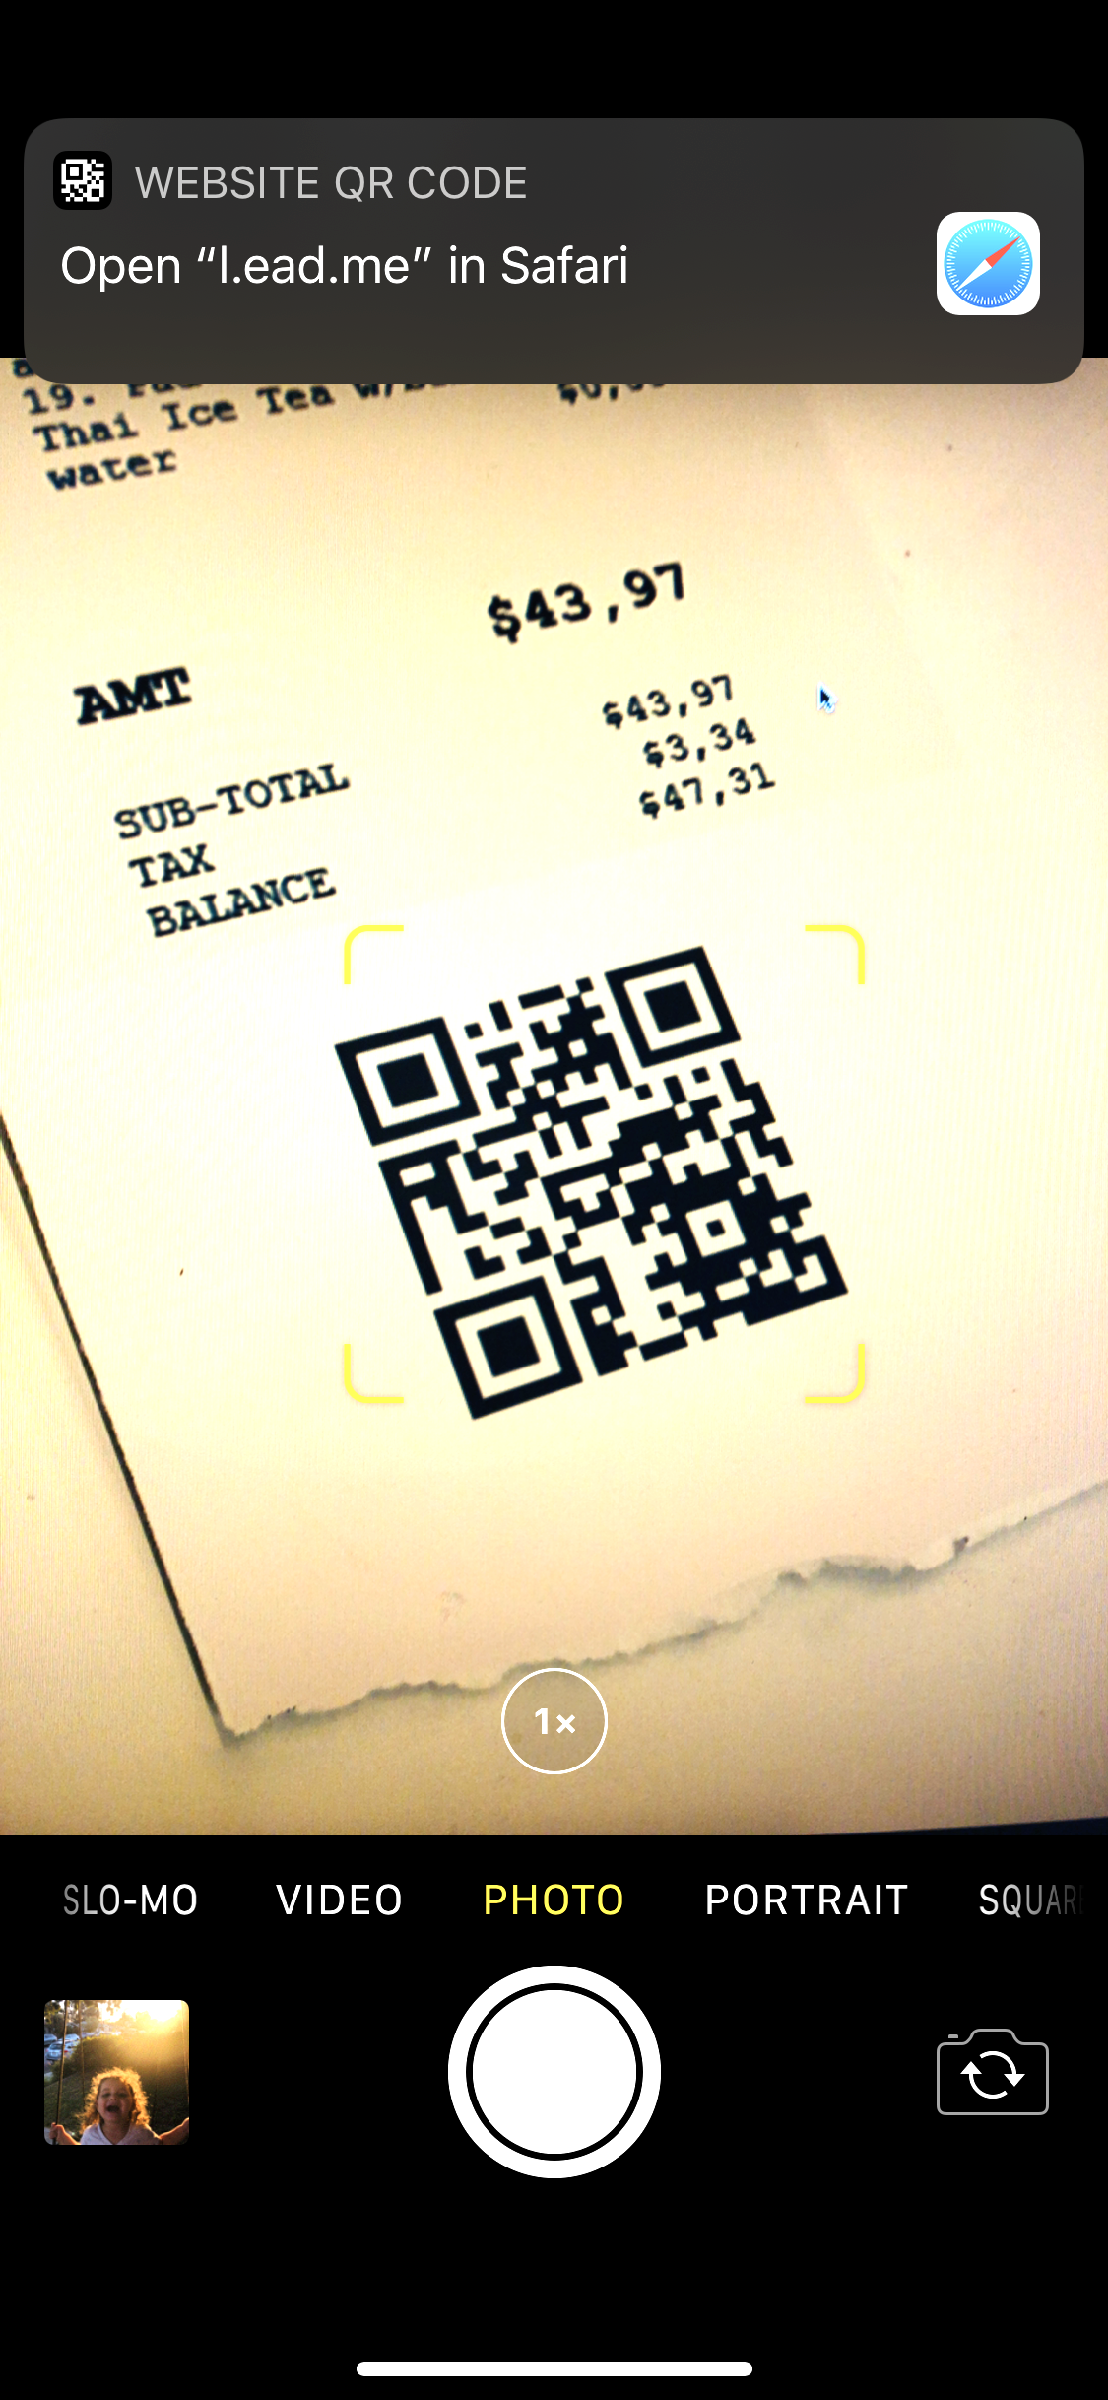
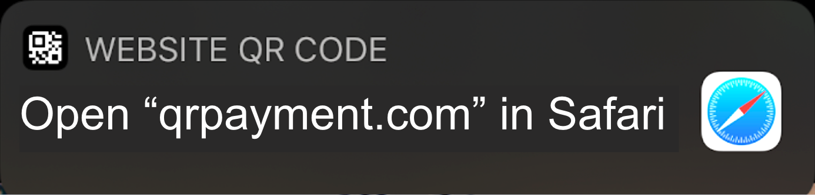
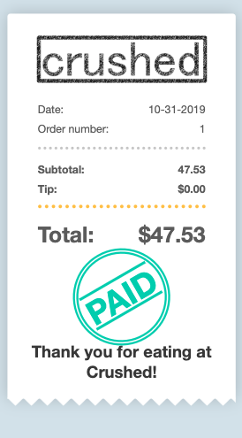

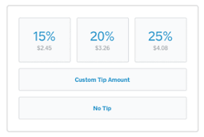

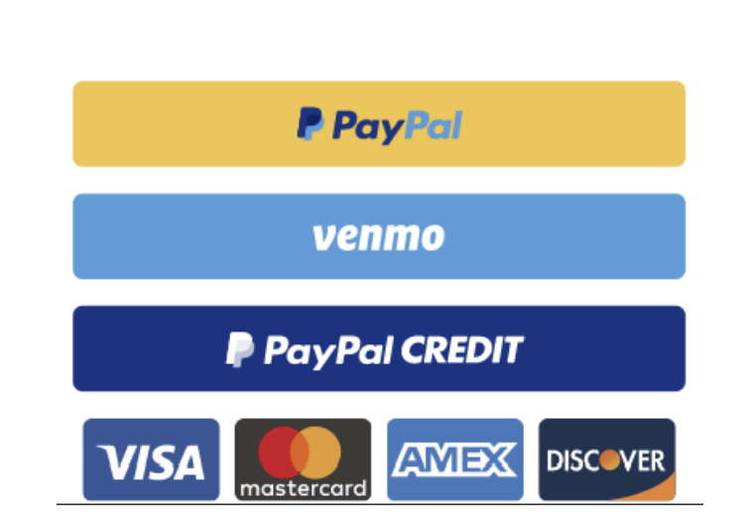

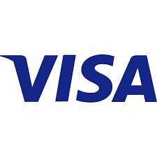
Payment Experience
Unique QR code on receipt
Scan QR code with camera
Pay through browser
Vendor and customer get instant confirmation
qr-code.io
qr-code.io
Open “qrpayment.com” in Safari
EYE OF THAI-GER
$47.31
EYE OF THAI-GER
$47.31
qr-payments.com
qr-code.io
TOTAL $56.76
TOTAL $56.76
No app required
PAID
• • • • • • • • 4658
We’ve notified your server, so you can leave whenever you’re ready.
QR-CODE.IO

Slide 17
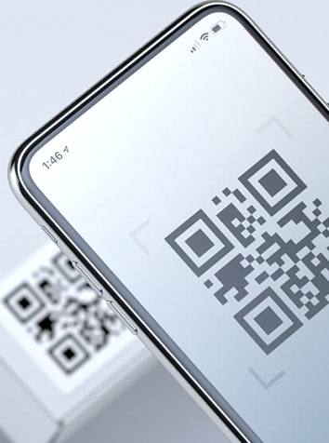
Are QR codes secure?
QR codes can be encrypted
Payment information is stored
Often when a QR code is displayed, it’s in a public location, placed by there someone anonymous.
With restaurants and bars, the bill is provided by a trusted establishment with a chain of custody directly to the server.
QR-CODE.IO

Slide 18
Market Size
Restaurant goers + mobile payments
$863 billion: Restaurant industry's projected sales (c 2019) - Restaurant.org
Have used phone instead of a payment card to make purchases when checking out (c 2016) - 40% - creditcards.com
Is this online or in retail
Payment solutions (browser and mobile friendly)
Apple Pay
PayPal
PayPal accounts for 14% of online payments made in the U.S and 55% of adults in US having PayPal accounts - link
“Visa and Mastercard still visibly dominate the payment landscape...However, PayPal is a close second, as it accounts for 14% of payments in the US” link
FAQ
Q: don’t all of these services have their own QR code reader?
A: Yes, but retailers aren’t offering QR codes on bills.
QR-CODE.IO

Slide 19

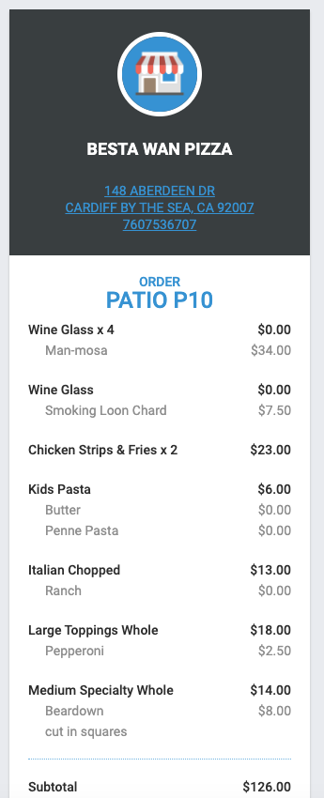
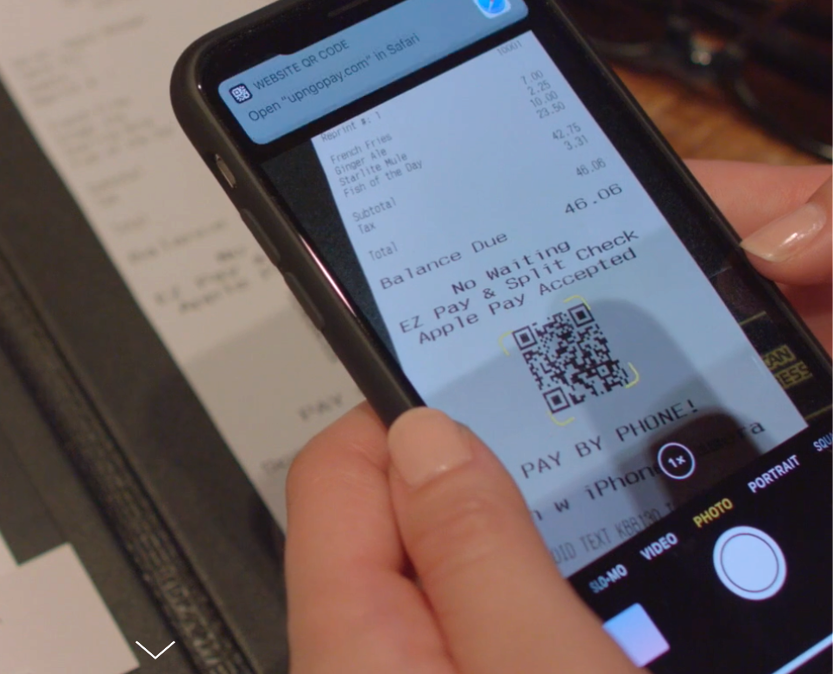


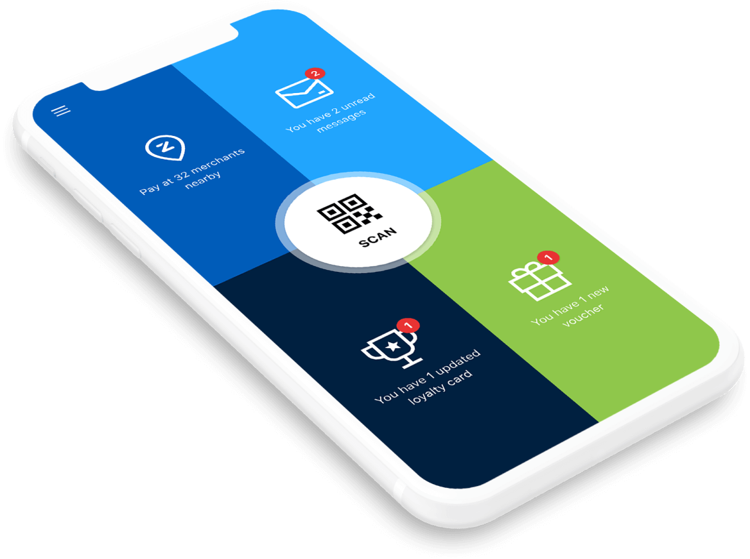

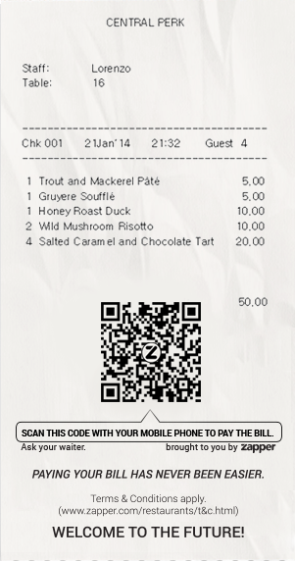
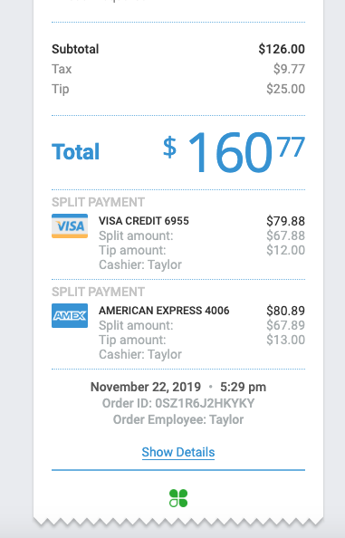



Competitors
Clover
End-to-end POS systems with “apps” including POS “scan-to-pay” with integrated QR codes and web receipts
QR on receipt
Bill splitting
Web Receipt
No app required
Restaurant must use Clover POS, and have QR function added as “app”
Zapper
Mobile payments provider for restaurants who uses QR codes. Participating restaurants add a QR Code on every bill. Customers can pay using the Zapper app.
UpNGo
API integration into POSs, QR printing on checks, web-based payments, apple pay, check splitting - no app.
QR-CODE.IO

Slide 20
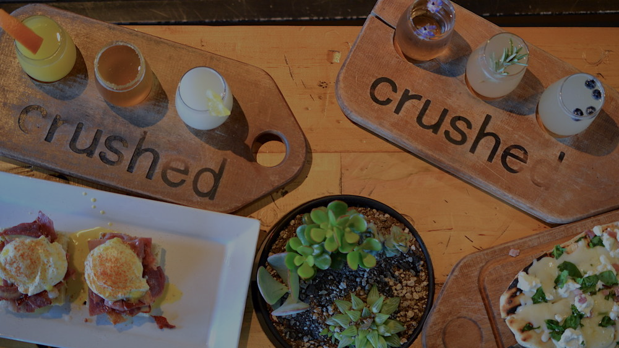
Pilot at Crushed in PB
No
QR-CODE.IO

Slide 21


Why Crushed?
Crushed’s demographic is inline with our target
18-24 typical age range, mobile-first, casual
It’s both a restaurant and bar
This means we can run tests in both use-cases
Using a modern POS and kitchen workflow
Future growth will require a software-based POS for API integration, and a server staff willing to try new things.
Relationship with owners and management is strong
This will allow our pilot to have access to staff, POS, and customers for running the pilot with little constraints.
QR-CODE.IO

Slide 22




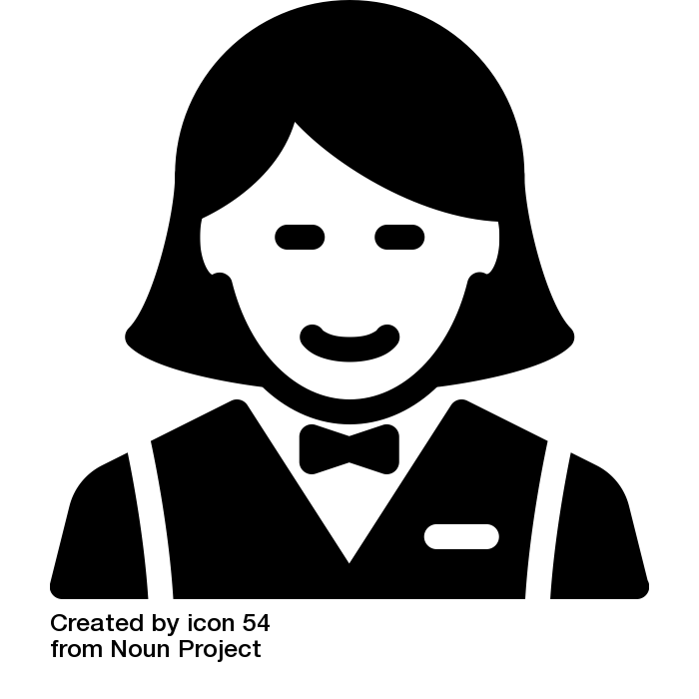
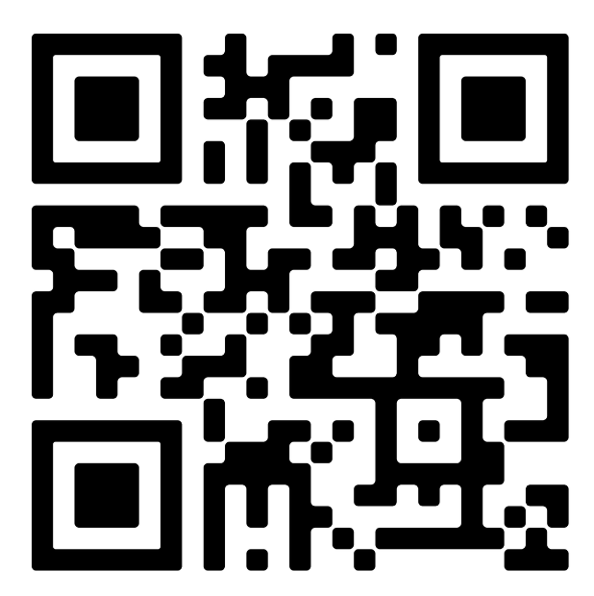
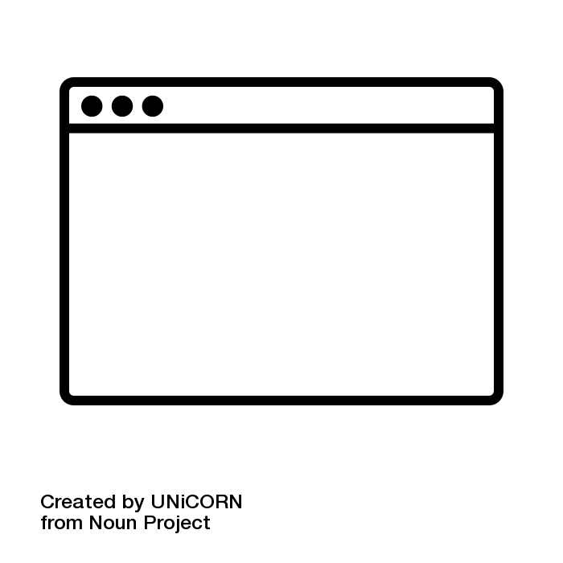
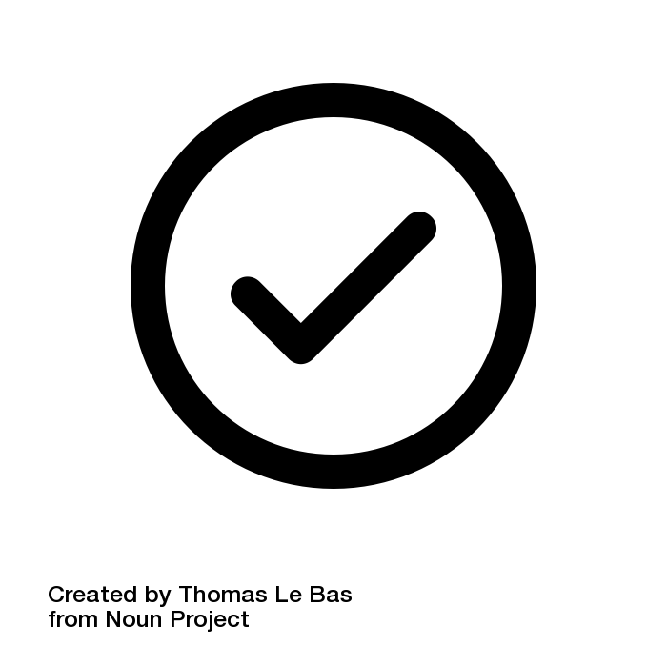

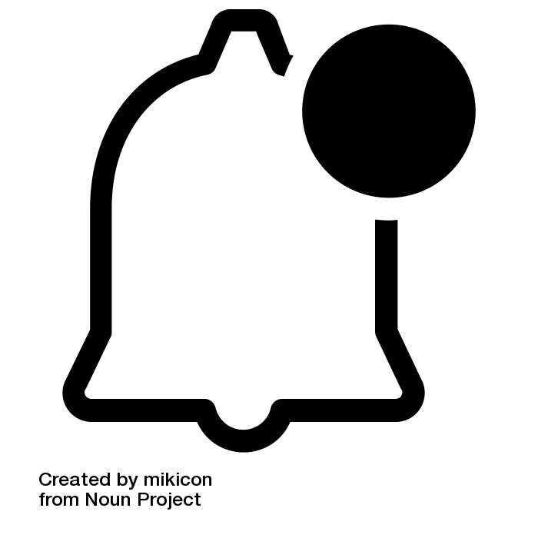

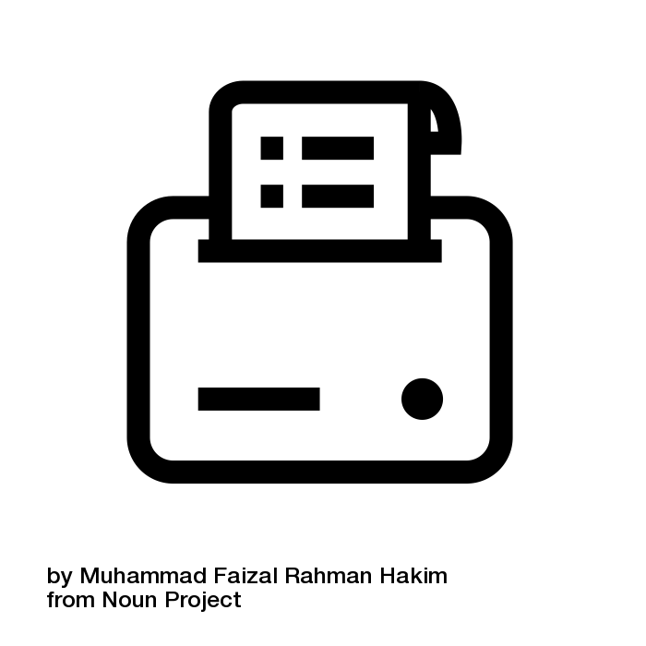





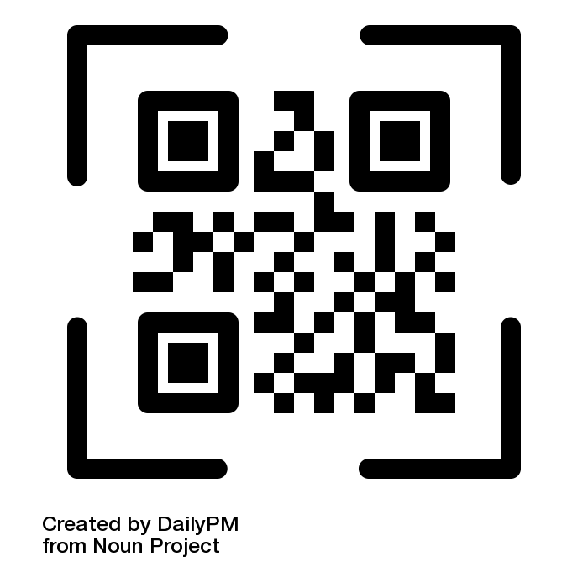
Pilot service map touchpoints
Add QR Code to Receipt
Observation
Gets Confirmation
Informs server
Tech
Check printed from POS
Drops receipt at table
Server
Enter in POS
Customer
Scans QR
Clicks Payment
Gets Confirmation
Customer Leaves
QR-CODE.IO

Slide 23






Pilot Funnel Metrics
We will measure and compare the payment funnel below for customers using credit vs QR code. Our hypotheses are:
QR-code.io saves time/steps/effort for servers and customers
QR-code.io will result in higher tip amounts
QR-code.io will increases table turnover (increasing restaurant revenue AND server tips)
Customers will prefer QR-code.io over credit card
Pay
 | QR receipts to table | QR or Credit | QR codes scanned | In-browser payment click | Payments Completed | Tips | Post-QR survey
Time |  | QR or Credit |  |  |  |  | NO or YES
n
$
% Prev
% Tot
QR-CODE.IO

Slide 24
Known Challenges
POS Integrations at scale
Adoption
Businesses to see benefit?
Customers trust to try?
Customers try it again?
Competitors?
Legal / financial compliance
QR-CODE.IO

Slide 25

ARCHIVE

Slide 26
DESIGN ASSETS

Slide 27
QR-CODE.IO
QR Code Brand Reference

Slide 28

qr-code.io
Website - QR-code.io
Mobile-first website
qr-code.io
QR-CODE.IO

Slide 29
ARCHIVE

Slide 30
QR-CODE.IO
QR Code Payments for Restaurants and Bars
No

Slide 31
QR-CODE.IO
QR Code Payments for Restaurants and Bars
No

Slide 32
APIs
Payments
Venmo - https://www.braintreepayments.com/features/venmo
In-browser (stored CC/debit) - Stripe & Stripe api
Amazon Pay API buttons and sign up form
PayPal API
Apple Pay - https://applepaydemo.apple.com/
Google pay - https://developers.google.com/pay/api
QR Code Generators
AWS+ Lambda
https://github.com/skyzyx/lambda-qr
https://blog.passkit.com/how-to-use-golang-aws-lambda-to-build-a-scalable-barcode-generator-part-1/
No

Slide 33
Jeremy
AWS is a must and give James access
Talk to Andy
James
Review APIs and let jeremy know which req
Domain ?
Paypal button placement:
https://developer.paypal.com/docs/checkout/best-practices/feature-paypal/#examples
EYE OF THAI-GER
$47.31
qr-payments.com
TOTAL $56.76
PAID
Would you like a receipt?
Yes
No
Done!
Vendor gets confirmation
Could collect emails

Slide 34



System Map for QR Payments in Retail
Vendor
Create Unique QR Code
Receipt info, Vendor Info and Security Info
POS
API from POS
API to POS
Print Receipt w QR
Deliver Receipt to Customer
POS Confirmation
Customer
Scan QR
Web Checkout
Web Confirmation

Slide 35
Pilot Assumptions
273 total bills paid, for ave $50 (based on pilot location)
10% customers paying their bill will scan a QR code on the bill. (trust at restaurant they’ve just eaten at)
30% of those will complete the transaction
80% of users who complete a transaction will feel that this experience was more convenient than using a credit card because of a) steps b) wait time, and c) tip math
90% of those users would do it again

Slide 36

Demographics
Future of Money - Study

Slide 37

QR Code Payments in China (and Japan)
“WeChat, China’s most popular messaging app, has an in-built QR Code scanner. An estimated half a billion people in China actively use WeChat on their smartphones...This removes the need to download a dedicated QR Code scanning app - a problem prevalent in the West….Chinese giant Alibaba is also promoting the technology”
Mobile payment must become widespread in order to attract Chinese tourists
https://www.linkedin.com/pulse/qr-code-payments-chinese-revolution-annie-guo/
In 2017, $15.4 trillion in mobile payments were processed, 54% by Alipay, and 39% by Tencent’s WeChat Pay. BankInnovations.net
Vending machine in China that only accepts QR payments - no credit or cash.

Slide 38
By 2021, emarketer projects that 30.8% of users in the US will
Vending machine in China that only accepts QR payments - no credit or cash.
https://www.americanbanker.com/news/why-chinas-mobile-payments-revolution-matters-for-us-bankers
QR-CODE.IO

Slide 39

Starbucks QR payment requires POS
QR-code.io leverages the customers’ smartphones as the POS.

Slide 40

More stats
Restaurant goers + mobile payments
73% of diners agree that restaurant technology improves their guest experience. (Source)
95% of restaurateurs agree that restaurant technology improves their business efficiency. (Source)
qr-code.io

Slide 41

Payment UX
Open “qrpayment.com” in Safari
qr-code.io
qr-code.io
EYE OF THAI-GER
$47.31
EYE OF THAI-GER
$47.31
qr-payments.com
TOTAL $56.76
TOTAL $56.76
No app required
PAID
No app required
No
• • • • • • • • 4658
Unique QR Code
Encoded amount, vendor id, security string, etc.
Scan with native camera app in iOS and Android
No app needed. URL notification pops up
Web-based payment
No app or account. Use of in-browser credentials
Done!
Vendor and user get instant confirmation

Slide 42

QR payments typically require an app (and user account) for each brand
App download, account creation, payment info added, and little added benefit all remain barriers to adoption.
“The market is still waiting for a serious player, or by a combination of bank and fintech company, to burn money to earn market share.” link
Notable service providers link
Alipay
BharatQR
Easypaisa
JazzCash
Masterpass^{[10]}
mVisa
WeChat Pay
Paytm
Google Pay (Tez)
PhonePe
Amazon Pay
Standards also exists to determine the content of the payment QR codes like the EPC QR code in Europe.
Walmart, Target, Starbucks, Dunkin Donuts, 7-11, Macy’s, CVS all provide QR code payment at POS...with their app.
MasterCard offers a QR code generation service for integration into other apps.
QR-CODE.IO

Slide 43
Pilot notes meeting w/ Andy and James
Nov 21, 2019
sign receipt
stripe email
receipt
—
Paypal production keys
Business account
Error handling
---
KEY FEATURE - Email and text message lists
James to find out what info we get from stripe, apple pay, PayPal,
Alt. can we get phone via the system -> capture phone via single qr
Pilot Pace
5 checks / hour on a tuesday
4 horus
Figure out QR-Code.io opperating costs
Processor fees (i.e. stripe, apple pay) from our pocket - what are fees on stripe
Hosting - $100/mo for us service?
What we could charge?
4300 checks/mo -> 10% capture -> 430 emails/phones/mo = $150/mo
$0.25/contact
need a privacy policy
QR printing
Qr as big as you want "bumpers"
look at snap chat's qr code
QR-CODE.IO

